Slide 1



FITFLOW
Advance Fitness Trainer
Group Id-24-25j-083

Slide 2



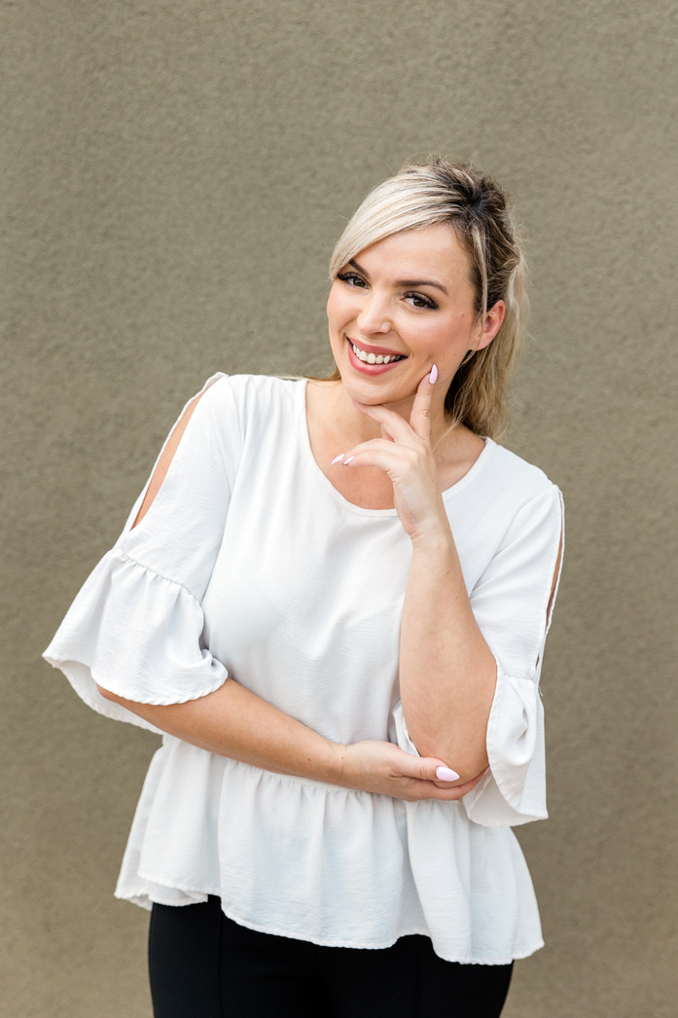


OUR TEAM
Edirisuriya M.G.R
IT21380846
Athukorala A.P.U
Ranasinghe R.M.P.A
Pinidiya Y.H
IT21304224
IT21384738
IT21387012

Slide 3


INTRODUCTION
This app introduces a comprehensive methodology for fitness tracking including meal planning, Real time biomechanics, Dynamic body composition analysis, health forecasting and much more.

Slide 4
This research addresses difficulties that pose to people when tracking their fitness, planning a healthy meal, getting real-time biomechanics and body composition analysis by themselves.
We Try to develop a solution to overcome those difficulties using a single mobile application .
RESEARCH
PROBLEM

Slide 5

MAIN
OBJECTIVE
Our objective is to create a comprehensive and personalized fitness app that provides real-time support, detailed insights, and accurate recommendations to enhance users' physical well-being and effectively guide them on their fitness journey.

Slide 6

SPECIFIC
OBJECTIVES
Enhancing Exercise Accuracy and Safety : real-time biomechanics analysis with AI and image processing
Personalized Health Monitoring and Forecasting : AI-powered dynamic body composition analysis
Optimizing Nutritional Intake: food scanning technology with image processing
Tracking Progress Effectively : AI-powered progress tracker that provides multi-metric tracking
Tips for maintaining effective body measurements : This is determined by a model trained on body measurements taken monthly.

Slide 7

MARKETABILITY
With its innovative features and alignment with market demand, this app is poised to revolutionize the fitness industry.

Slide 8
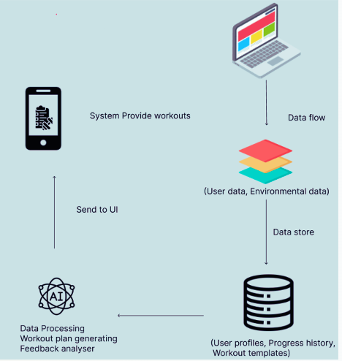
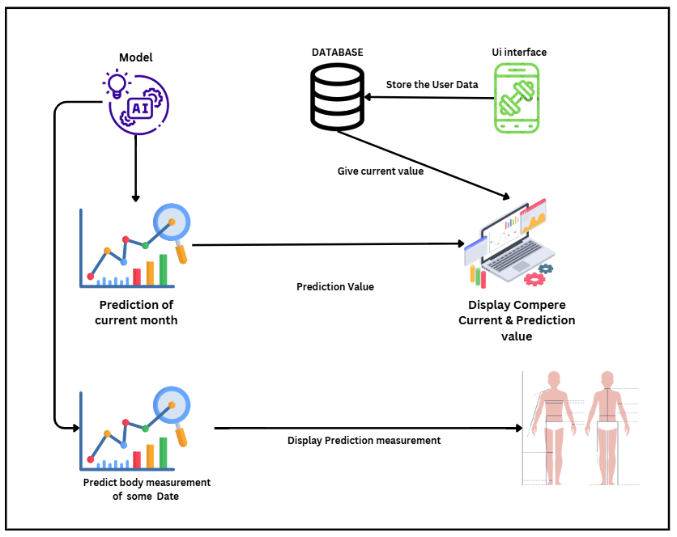



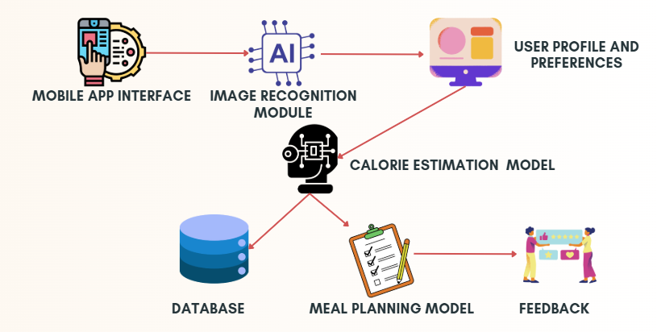





USER
Enter Current Body measurement
User Interface
captured video
camera module
Display Feedback
Streams video
Image Processing Module
extracts key points
AI model
Analyzes Data
saves Analysis
Data Storage
Retrives Data
Feedback Module
Stored User Data

Slide 9
METHODOALOGY
Layer | Technologies
Front-End | JAVA
Back-End | Python
Database | Firebase
AI/ML | TensorFlow (machine learning framework.)
Data analytics & Visualization | Matplotlib / Pandas

Slide 10
INDIVIDUAL
COMPONENTS

Slide 11

Component 01
AI-Powered Dynamic Body Composition Analysis and Health Forecasting.
Edirisuriya M.G.R
IT21380846

Slide 12



INTRODUCTION
THIS RESEARCH PRESENTS AN AI-POWERED FITNESS APP THAT PERSONALIZES WORKOUT PLANS BASED ON USER BIOMETRICS AND FITNESS GOALS. USERS INPUT THEIR AGE, HEIGHT, WEIGHT, AND EXERCISE PURPOSE, WHILE THE SYSTEM AUTOMATICALLY CAPTURES HEART RATE AND BLOOD PRESSURE VIA A FINGER-TOUCH CAMERA SENSOR. USING MACHINE LEARNING, THE APP SUGGESTS CUSTOMIZED WORKOUTS, ENSURING SAFE AND EFFECTIVE TRAINING.

Slide 13
RESEARCH PROBLEM
UNLIKE TRADITIONAL SYSTEMS THAT OFFER STATIC WORKOUT ROUTINES, THE CHALLENGE LIES IN CREATING AN AI SYSTEM CAPABLE OF DYNAMICALLY ADAPTING TO USER PROGRESS AND PREFERENCES WHILE MAINTAINING PRECISION AND USER SATISFACTION.

Slide 14


MAIN OBJECTIVES
THE MAIN OBJECTIVES OF AN AI-DRIVEN PERSONALIZED WORKOUT SYSTEM CAN BE CATEGORIZED INTO USER-CENTRIC, TECHNOLOGICAL, AND BUSINESS OBJECTIVES. THESE OBJECTIVES ENSURE THE SYSTEM ALIGNS WITH USER NEEDS, LEVERAGES STATE-OF-THE-ART TECHNOLOGIES, AND ACHIEVES COMMERCIAL SUCCESS.

Slide 15


LITERATURE REVIEW
AI-driven personalized workout systems have demonstrated significant potential in delivering effective and engaging fitness solutions. Current literature underscores the importance of personalization, real-time adaptability, and continuous optimization. Future work should address existing challenges like data privacy, user trust, and hybrid AI models, paving the way for broader adoption and improved outcomes.

Slide 16
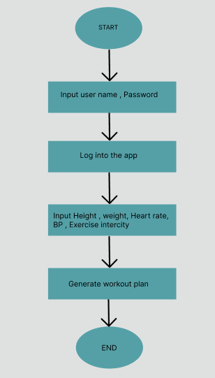

FLOW CHART

Slide 17

TOOLS AND LIBRARIES
PANDAS: FOR DATA ORGANIZATION, STRUCTURING, AND CSV EXPORT.
NUMPY: FOR RANDOM NUMBER GENERATION AND CALCULATIONS.
PYTHON CONTROL STRUCTURES: FOR LOGICAL DECISION-MAKING

Slide 18

TECHNOLOGIES
Layer | Technologies
Front-End | Java
Back-End | Python
Database | Firebase
ML | TensorFlow
Cloud Services | Firebase
Security | Used https , Because host in web

Slide 19

METHODOLOGIES
Methodology | Purpose
Rule-Based Logic | Assign workout plans based on BP , Heart rate, gender and intensity.
Randomized Data Generation | Simulate user profiles with realistic attribute ranges.
Data Structuring with pandas | Organize data into a tabular format for easy storage and manipulation.
CSV Export | Save generated data for further analysis or model training.

Slide 20
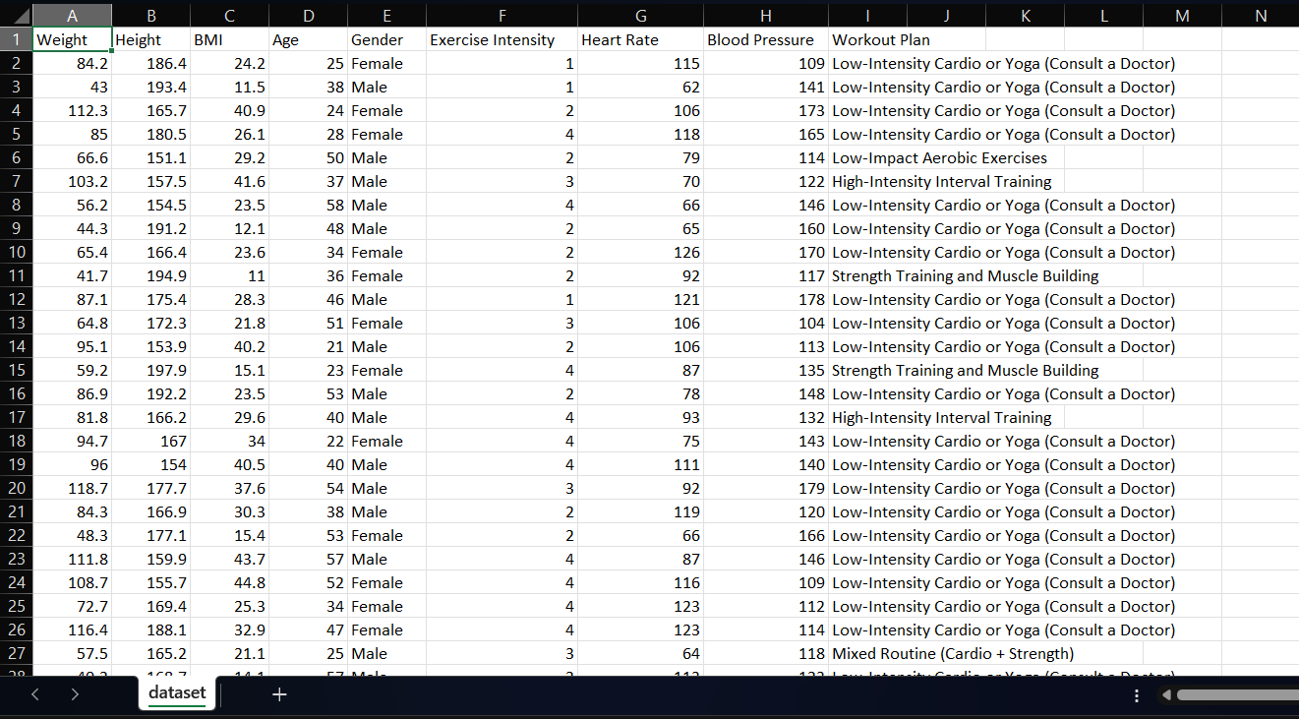
DATASET
INCLUDE FIVE HUNDRED THOUSAND & ONE COLUMNS IN THIS DATASET.

Slide 21
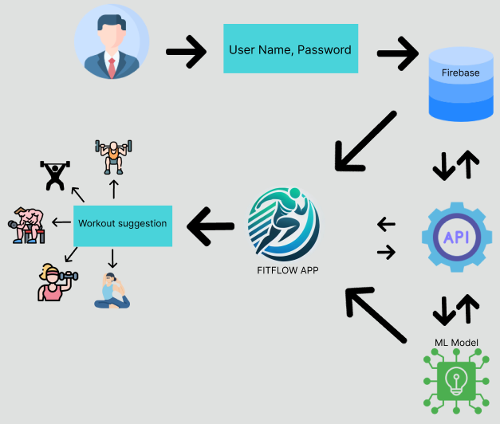
SYSTEM DIAGRAM

Slide 22
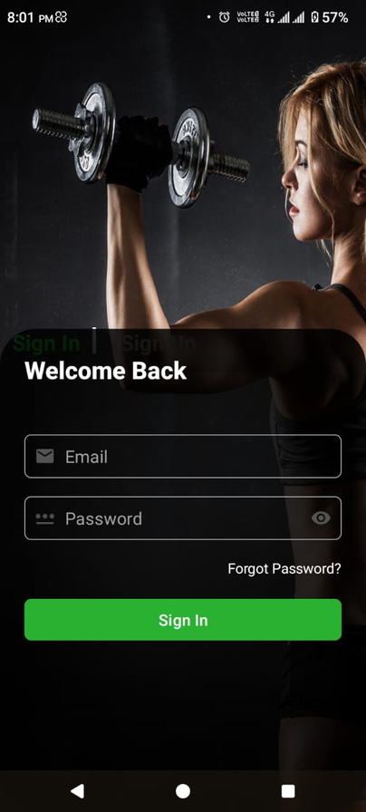
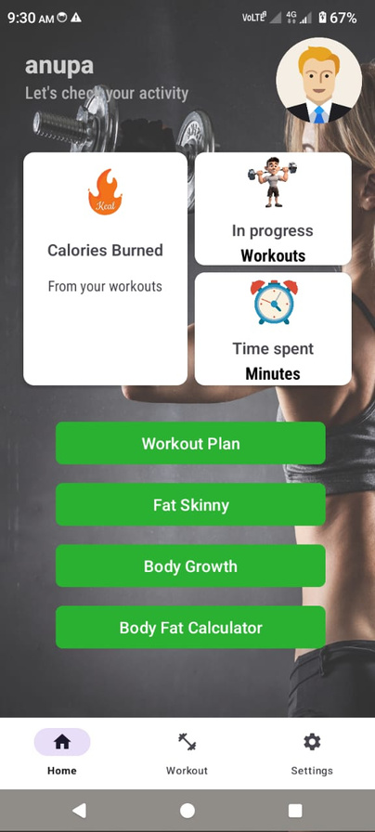
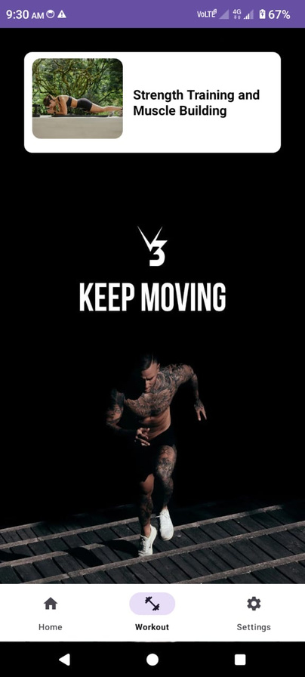
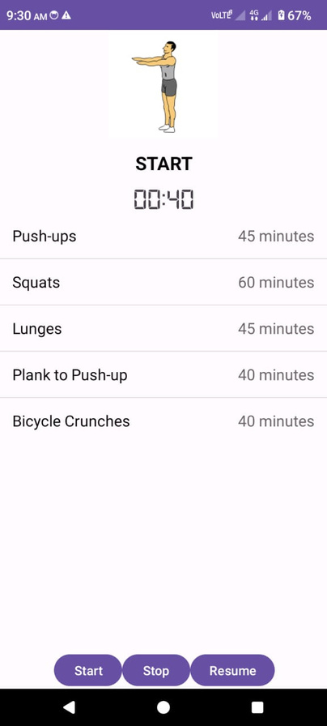
MOBILE APP INTERFACES

Slide 23

RESULT & DISCUSSION

Slide 24
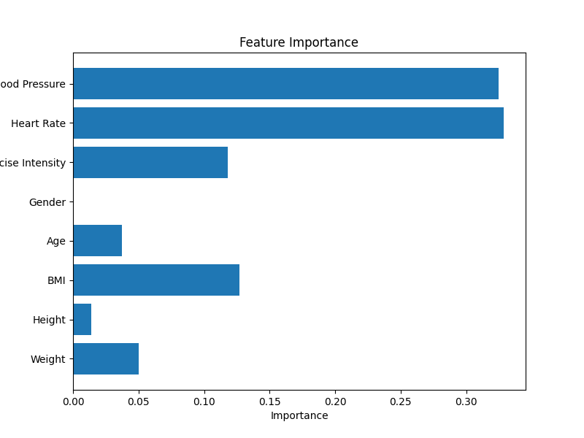
COMPONENT EVALUATION METRIX
USED RANDOM FOREST CLASSIFIER ALGORITHM. SO WE CAN GENERATE THESE REPORTS AS WELL.
SPECIALLY CONSIDERING THE HEART RATE, BLOOD PRESSURE & EXERCISE INTENSITY

Slide 25
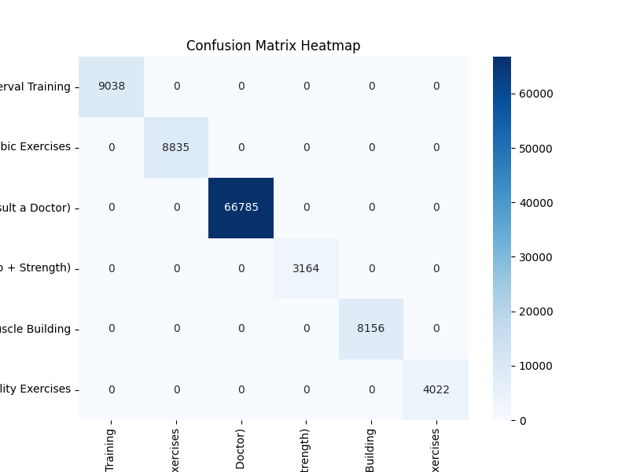
CONFUSION METRIX

Slide 26
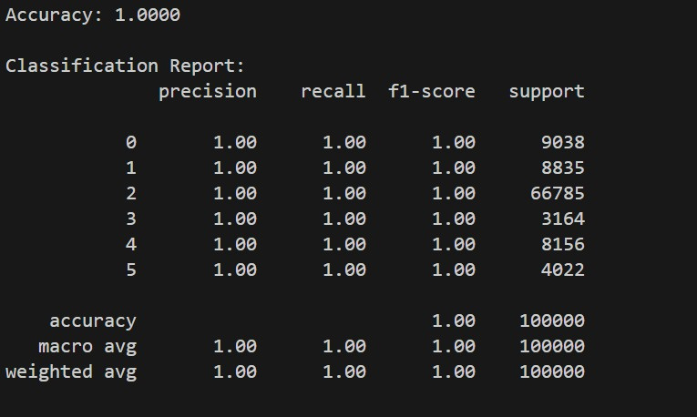

Slide 27
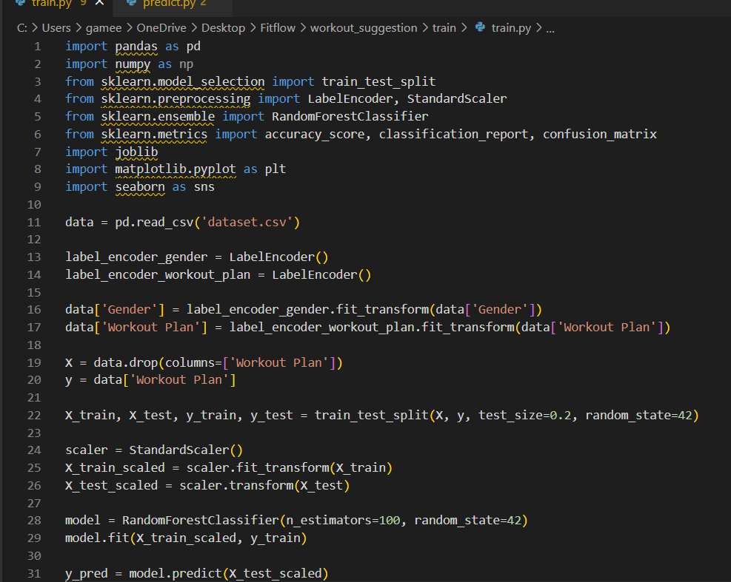
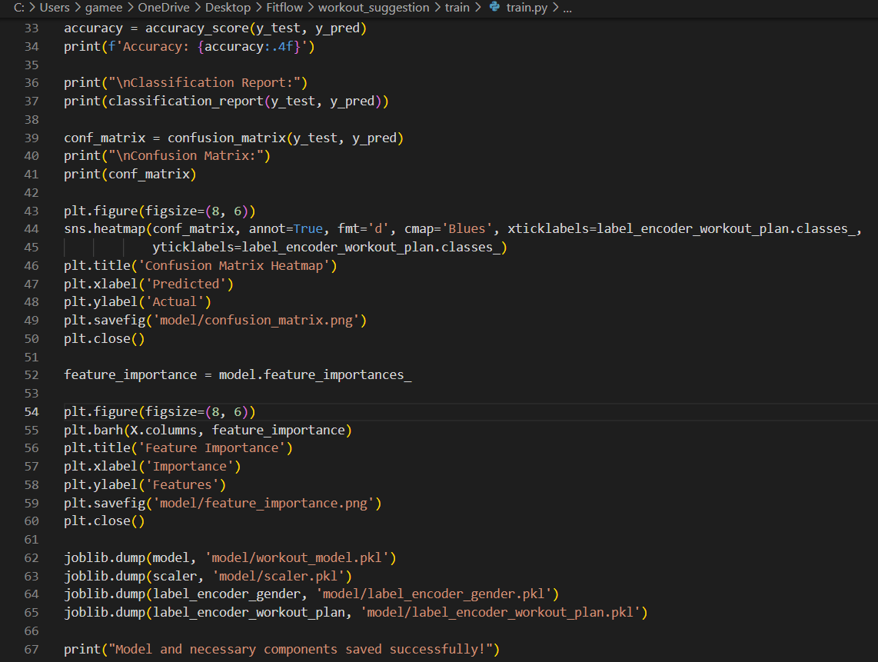
PROOF OF MODEL TRAIN

Slide 28
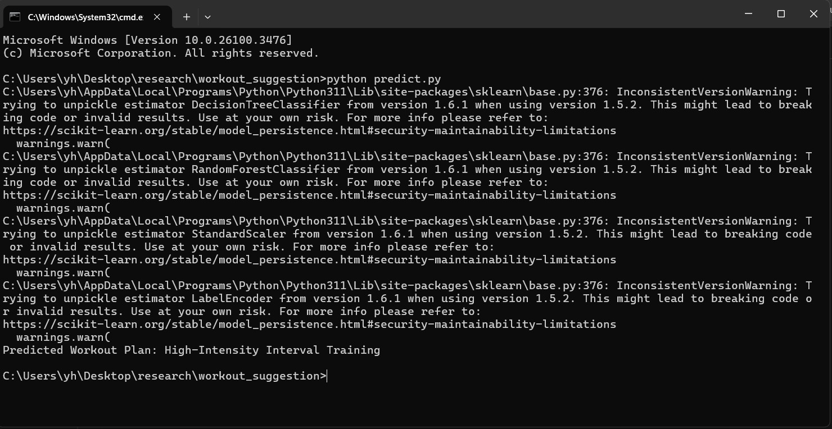
PROOF OF PREDICTION

Slide 29

IN FUTURE
Develop the IOS version.
Integration with Wearable devices.
Voice-Guided Workouts
Finally released into the market

Slide 30

COMMERCIALIZATION
REAL WORLD APPLICATION
TARGET AUDIENCE
Who will use or buy this?
Personal Fitness Coaching.
Telehealth or Remote Training.
Fitness Startups & Gyms.
Fitness Enthusiasts
Beginner to Intermediate Users
Trainers and Coaches
Busy Professionals
THESE FEATURE SOLVES ACTUAL USER PROBLEMS

Slide 31

REFERENCES
WHO. (2022). PHYSICAL ACTIVITY. https://www.who.int/news-room/fact-sheets/detail/physical-activity
ACSM. (2023). American College of Sports Medicine Guidelines for Exercise Testing and Prescription.
Thomas, J. R., Nelson, J. K., & Silverman, S. J. (2015). Research Methods in Physical Activity.
1. Academic & Industry
3. AI & Personalization in Fitness
2. Technology & Tools
Ribeiro, F. N., et al. (2020). AI-based systems for personalized health and fitness.
Kumar, S., et al. (2021). Machine Learning in Fitness Applications: A Review.
Google. (2024). Firebase Documentation. https://firebase.google.com/docs
TensorFlow Developers. (2024). TensorFlow Documentation. Retrieved from: https://www.tensorflow.org/

Slide 32


Component 01
AI Driven meal planner and
calory counter
Athukorala A.P.U
IT21304224

Slide 33
INTRODUCTION
This Function introduces a mobile app feature that uses image recognition and AI to estimate meal calories and provide personalized meal plans, making healthy eating simple and tailored to individual needs.

Slide 34

MAIN OBJECTIVE
THIS RESEARCH AIMS TO DEVELOP A MOBILE APP FEATURE COMBINING IMAGE-BASED CALORIE ESTIMATION WITH AI-DRIVEN PERSONALIZED MEAL PLANS. IT FOCUSES ON IMPROVING USER ENGAGEMENT, DIETARY ADHERENCE, AND HEALTH OUTCOMES WHILE ENSURING ACCURACY AND ADAPTABILITY.

Slide 35
RESEARCH PROBLEM
HOW CAN WE SOLVE THE PROBLEM OF USERS INABILITY TO KNOW THEIR CALORIES OF THE MEAL, PLAN THEIR MEALS HEALTHILY BY ON THEIR OWN, HOW CAN A USER MAKE DIETARY MANAGEMENT EASIER, MORE ACCURATE AND TAILORED TO INDIVIDUAL NEEDS?
WE HOPE TO GIVE A SOLUTIONS TO THOSE PROBLEMS.

Slide 36
SPECIFIC
OBJECTIVES
1. DEVELOP FOOD IMAGE RECOGNITION ALGORITHMS FOR ACCURATE IDENTIFICATION OF FOOD ITEMS.
2. IMPLEMENT NUTRITIONAL ANALYSIS ALGORITHMS TO PROVIDE DETAILED DIETARY INFORMATION.
3. CREATE DAILY PERSONALIZED MEAL PLANS BASED ON USER BIO DATA AND FEEDBACK
4. CREATE A USER FRIENDLY MOBILE APP TO GET THE FULL POTENTIAL OF MODELS DEVELOPED

Slide 37
RESEARCH GAP
Aspect | Existing Solution | Gaps identified | Proposed approach
Calorie Estimation | Most applications rely on manual input for calorie tracking or simplistic models with limited food item recognition. | Lack of automated, accurate calorie estimation from images. Limited accuracy in recognizing diverse and mixed meals. | Utilize advanced image recognition to identify meal components and provide precise calorie estimations.
Personalized Meal Plans | Existing tools provide generic recommendations without considering dynamic changes in user health, goals, and preferences. | Static meal plans fail to adapt to real-time user needs and preferences. | Use AI-driven algorithms to generate and adapt personalized meal plans based on real-time user data and feedback.

Slide 38
RESEARCH GAP
Despite the advancements in food recognition and calorie estimation systems globally, there is no dedicated system that accurately recognizes Sri Lankan food items and provides precise calorie estimations. Existing solutions are primarily trained on Western and globally common cuisines, making them ineffective for identifying local Sri Lankan dishes such as Parippu Wade, Ulundu Wade, Mallum, Lavariya, and more.

Slide 39

METHODOLOGIES
FRONT END - FLUTTER
Back end - Python
Database - Firebase
Cloud - Firebase
LIBRARIES-ROBOFLOW/ULTRALYTICS
MACHINE LEARNING FRAMEWORK-TENSORFLOW

Slide 40






SYSTEM DIAGRAM
USER PROFILE AND PREFERENCES
MOBILE APP INTERFACE
IMAGE RECOGNITION MODULE
CALORIE ESTIMATION MODEL
DATABASE
MEAL PLANNING MODEL
FEEDBACK

Slide 41
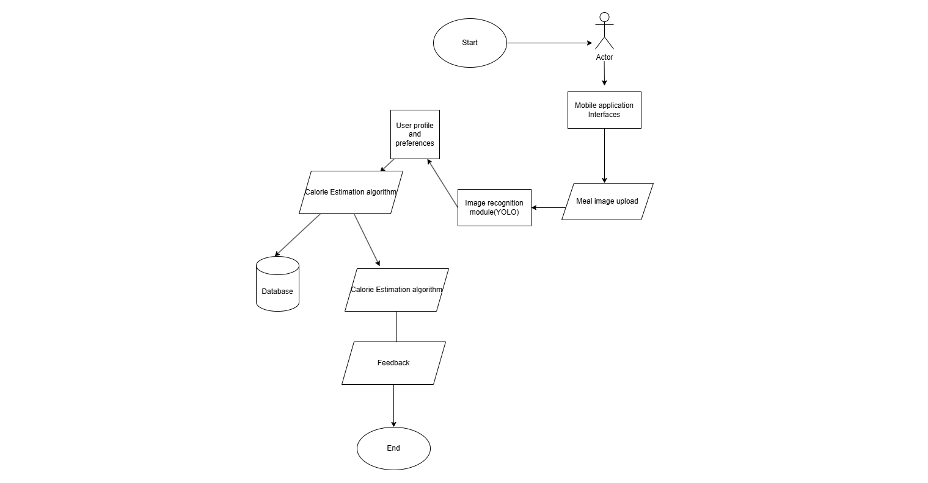
FLOW OF THE SYSTEM
FLOW CHART
M
Meal palnning algorithm

Slide 42
CURRENT PROGRESS
What i have completed...
Develop food image recognition algorithms for accurate identification of food items.
Implement nutritional analysis algorithms to provide detailed dietary information. (Predicting the calory count of the meal).
Implemented the meal planning model with getting user input.
Successfully Integrated Both backends with the flutter frontend

Slide 43
CHALLENGES
Dataset Collection - Had to manually Capture Sri Lankan Food Images
Calory mapping - Hard to find exact calorie amounts for some Sri Lanka Food Items

Slide 44
MARKETABILITY AND COMMERCIALIZATION OPPORTUNITIES
Target Audience and Market Potential
Primary target users for the Fitflow app, such as health-conscious individuals, fitness enthusiasts, and those with specific dietary needs or weight management goals.
Size and growth potential of the mobile health and fitness app market, which is expected to continue expanding rapidly in the coming years. According to the reports.
Outline marketing and promotion strategies to attract new users, such as social media campaigns, influencer collaborations, and targeted advertising.

Slide 45
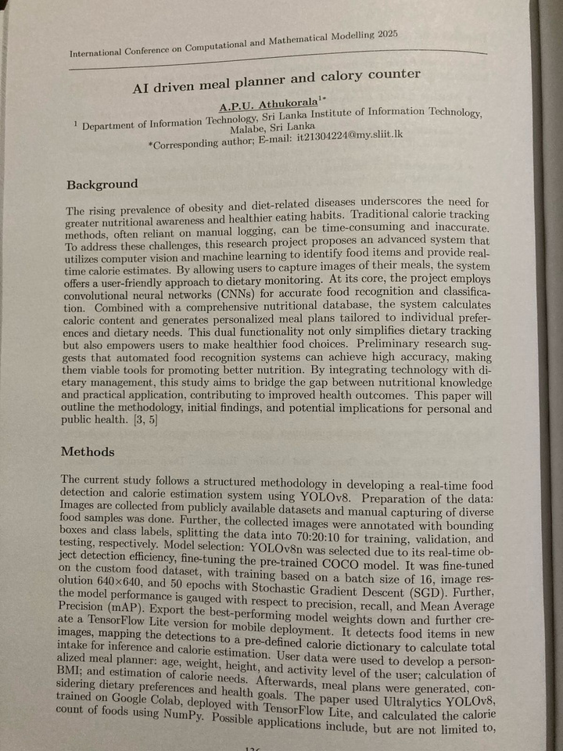
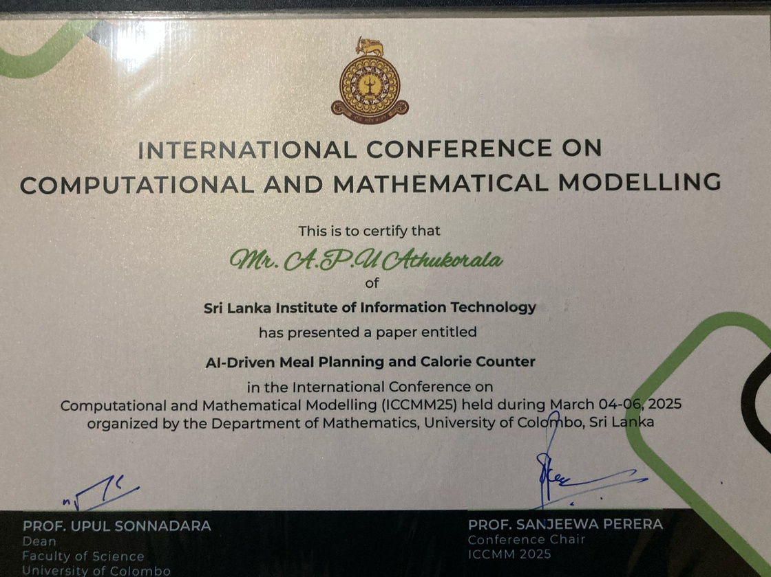
PUBLICATIONS
ICCMM2025 -University Of Colombo

Slide 46
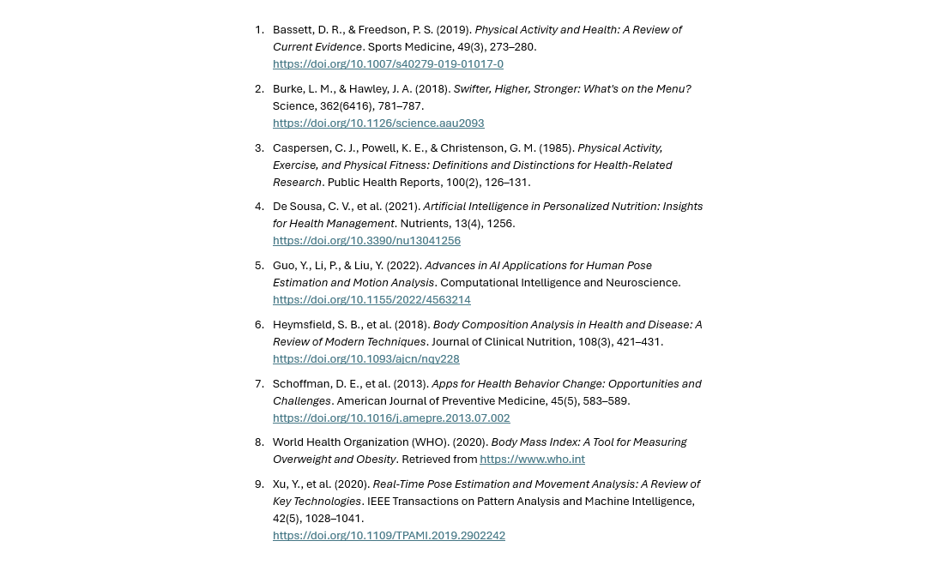
REFERENCES
Jaiswal, A., Babu, R., & Zadeh, M. Z. (2019). "A survey on food computing." ACM Computing Surveys (CSUR), 52(5), 1-36. DOI: 10.1145/3347713
Min, W., Jiang, S., Liu, L., Rui, Y., Jain, R., & Hauptmann, A. G. (2019). "A survey on food recognition and health applications." ACM Transactions on Multimedia Computing, Communications, and Applications (TOMM), 15(1), 1-34. DOI: 10.1145/3267931
Smith, A. (2022). "How AI and Image Recognition Are Transforming Calorie Counting." Medium. Available at: medium.com
FoodAI Blog (2023). "Personalized Nutrition Using Artificial Intelligence." Available at: foodai.com

Slide 47

COMPONET 02
Real-Time posture correction
Ranasinghe R M P A
IT21384738

Slide 48


INTRODUCTION
This component address the common problem of beginner fitness enthusiasts by Using Advance Image processing and Machine Learning techniques.

Slide 49

A major concern we addressed is whether individuals are executing exercises with proper form. Poor technique can contribute to injuries and ultimately limit the benefits of their workouts.

Slide 50
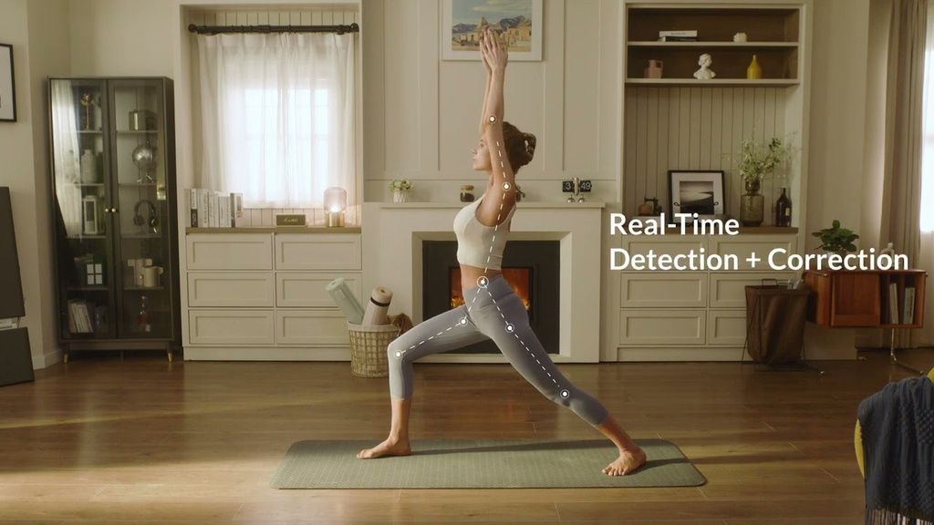
RESEARCH
PROBLEM
Existing mobile applications for exercise posture correction lack real-time adaptability to diverse body mechanics and exercise variations, often prioritizing speed over biomechanical accuracy, which limits their effectiveness in preventing injuries and improving workout outcomes.
this research focuses on exploring how posture correction and injury detection can enhance exercise safety and efficiency.

Slide 51
OBJECTIVES
To provide real-time or near-real-time feedback for posture correction
To increase accessibility to expert-level exercise guidance.
To evaluate the effectiveness of the app in improving exercise posture.
To ensure the app is user-friendly, scalable, and suitable for diverse populations.

Slide 52
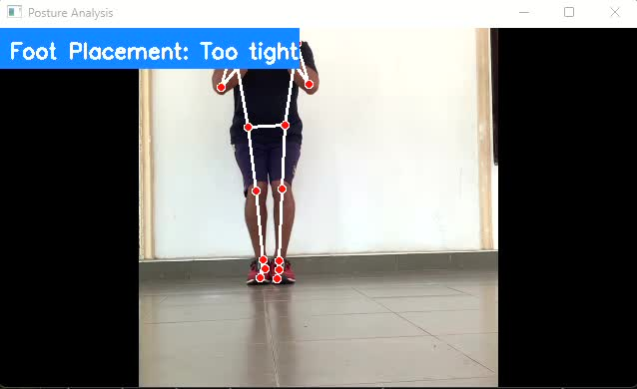
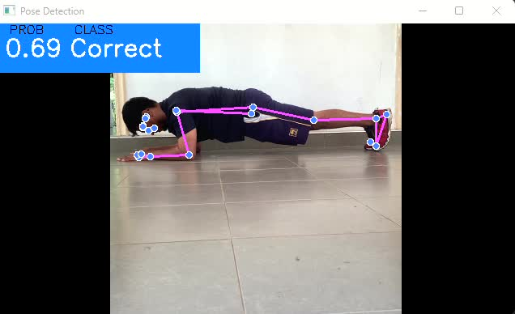
HOW IT WORKS

Slide 53
FRONTEND INTERGRATION

Slide 54
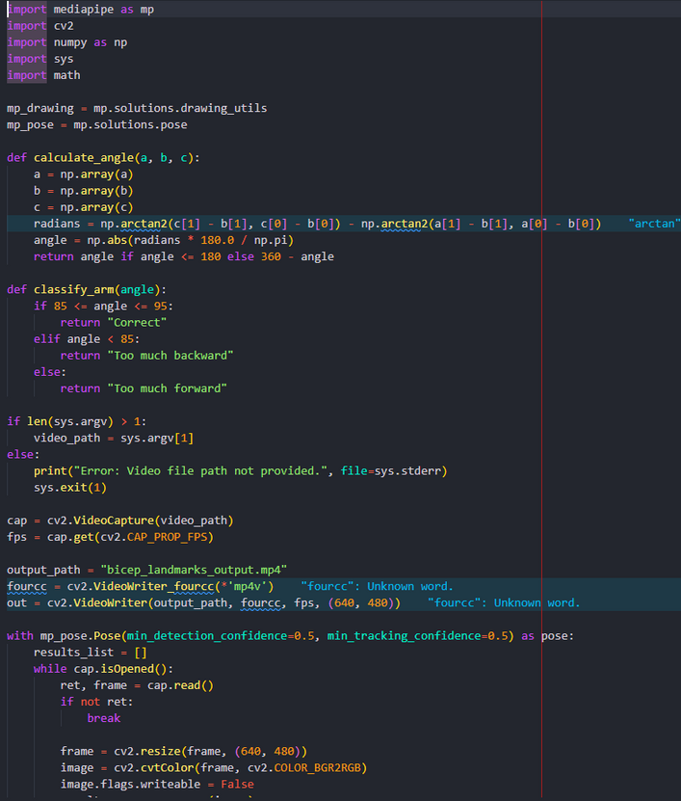
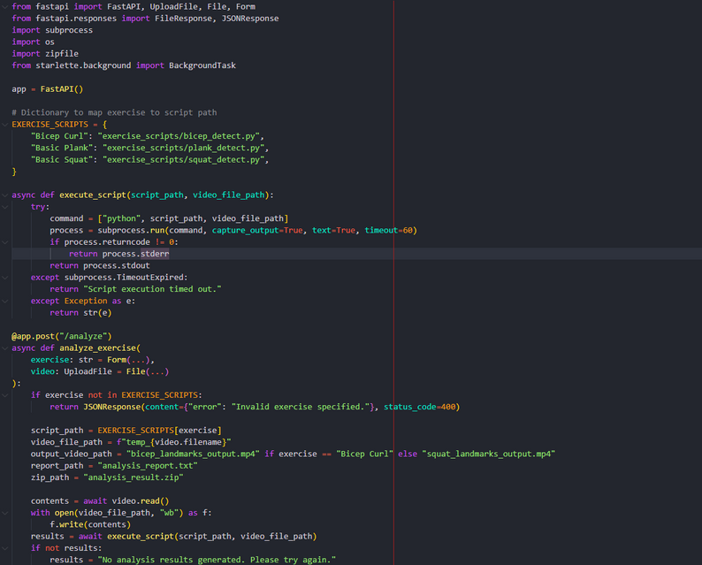
EVIDENCE

Slide 55



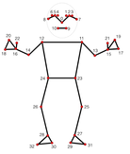


SYSTEM DIAGRAM
mobile applicationI
Displays Annotated video + Report
Exercise Selection UI
Camera Interface
Result UI
user
HTTP/POST recorded video
Backend server
http Endpoint
Posture Analysis Models
landmarks
detection
biomechanical Analyisi
video Processing PipeLines
MediaPipe Pose Engine
Exercise Models
FastAPI Server
Annotated video + Report

Slide 56
METHODOLOGY
machine learning framework
TensorFlow: is an open-source machine learning framework.
Object Detection and Tracking:
OpenCV: Used for computer vision and image processing tasks.
MediaPipe: Detecting and tracking objects of interest within video frames .
Data Analytics and Visualization:
Pandas: data manipulation and analysis
pickle: serialize and deserialize Python objects
Mobile Development:
Flutter (Android): Programming languages for native mobile app development.
Data Storages:
firebase

Slide 57
Difficulties And Different Approaches
Approach | Major Difficulties
WebSocket-Based Real-Time Analysis | Network latency, server processing load, synchronization issues
Java + MediaPipe | Limited AI capabilities, high CPU usage, difficult debugging and implementing issues with others components
Cloud AI Services | Expensive, high latency, privacy concerns
Technology Issues | Flutter doesn’t have a plugins for pose detection. smart phone camera’s quality issues. network quality issues.

Slide 58
IMPROVEMENTS
now users can review the results according to exact second
user can view a playback video of the exercise detection
Improvement of detection logic in bicep curl

Slide 59
FITFLOW 2.1
User can experience more range of exercises.
Voice and Audio Coaching
Offline Mode and Low-Light Adaptation

Slide 60


MARKETABILITY
Target Market Segments
Professional Sports Teams
Fitness Centers and Gyms
Personal Trainers
Rehabilitation Clinics
Individual Athletes and Fitness Enthusiasts
Unique Value Propositions
Real-time injury risk prediction
Personalized biomechanical insights
Performance optimization
Cost-effective injury prevention
“It's like having a personal trainer with you,
guiding you with personalized tips based on how you move.”

Slide 61
REFERENCES
R. Martinez and P. Wong, "Machine Learning Models for Predictive Injury Risk Assessment in Athletes," IEEE Journal of Biomedical and Health Informatics, vol. 26, no. 3, pp. 987-998, Mar. 2024.
E. Chen, S. Park, and T. Rodriguez, "Advanced Motion Tracking Systems for Real-Time Biomechanical Analysis," IEEE Access, vol. 11, pp. 45678-45690, 2023.
Bompa TO (1990). Periodization of strength: the most effective methodology of strength training, National Strength and Conditioning Association Journal, 12(5): 49-52.
Ackland DC, Pandy MG (2011). Moment arms of the shoulder muscles during axial rotation. J Orthop Res. 29(5): 658-67.
Baker JS, Davies B, Cooper SM, Wong DP, Buchan DS, Kilgore L (2013). Strength and body composition changes in recreationally strength-trained individuals: comparison of one versus three sets resistance-training programmes. Biomed Res Int. doi: 10.1155/2013/615901.
A. Smith, J. Doe, and M. Johnson, "Real-Time Biomechanical Analysis for Sports Injury Prevention: A Machine Learning Approach," IEEE Transactions on Biomedical Engineering, vol. 68, no. 4, pp. 1245-1256, Apr. 2023.
Norkin C, Levangie P (1992) Joint Structure and Function: A Comprehensive Analysis. Philadelfhia: Davis, 2, 105.

Slide 62

Component 04
captured the body measurement, Body image
& used that measurement to draw conclusions.
PINIDIYA Y.H
IT21387012

Slide 63
INTRODUCTION
Tracking body measurements is crucial for athletes to monitor fitness progress.
This research focuses on predicting future body measurements and classifying body shape using training models.
Body Measurement Prediction Model – Predicts an athlete’s measurements based on current stats, workout, and meal plans.
Body Shape Classification Model – Uses image processing to classify an athlete’s body shape into Fat, Normal, or Very Thin categories.

Slide 64
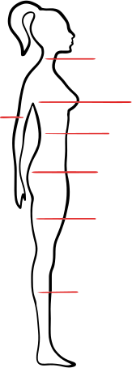

RESEARCH PROBLEM
It is necessary to see how fit an athlete is at the end of a month after making some changes to the diet and exercise plan each month.
Helps athletes and trainers adjust training and nutrition plans effectively.
Need to change or make
Meal Plan &
workout Plan
The difference between the player's body measurements within 30 days is required.
PLAYER
MONTHLY BODY MEASUREMENT

Slide 65
SPECIFIC
OBJECTIVES
Capture Monthly Body Measurement.
prediction body measurement in the future month.
Calculate the body fat percentage.
Calculate the BMI.
Identifying mass percentage.
capture Body image of the player.
athlete to provide a body shape prediction of how fat, thin, or normal he or she is.
Fitness Level Assessment Establish a standardized methodology to assess and evaluate the athlete’s fitness level each month, focusing on strength, endurance, flexibility, and cardiovascular health.

Slide 66
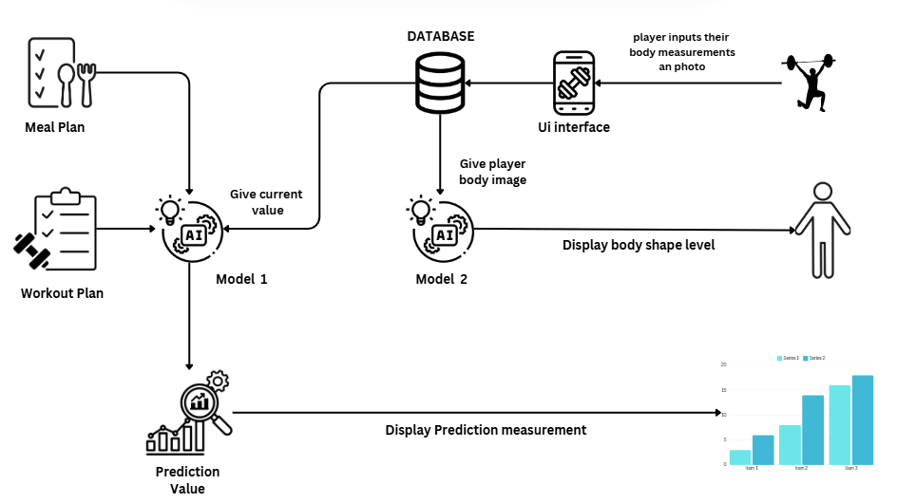
SYSTEM DIAGRAM

Slide 67
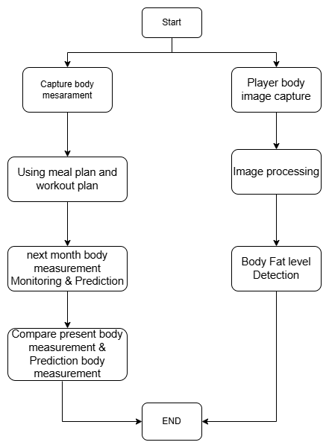
FLOW CHART
1) The process starts with two inputs.
Body measurements:
Body image capture:
2)First Path: Body Measurement Prediction.
A comparison is shown between the current and predicted body measurements using a bar chart.
3)Second Path: Body Shape Analysis.
The captured body image is processed using an AI-based model.
4)Final Step: Motivation and Insights.
The system displays motivation based on the body shape category.

Slide 68
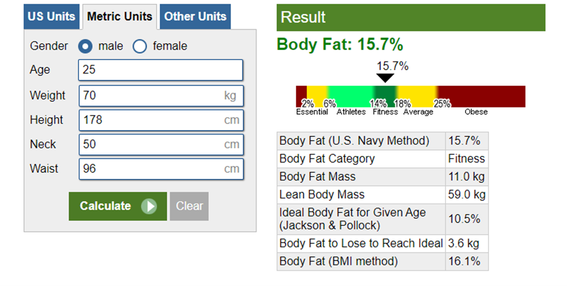
Body Fat Calculator
The Body Fat Calculator can be used to estimate your total body fat based on specific measurements.

Slide 69
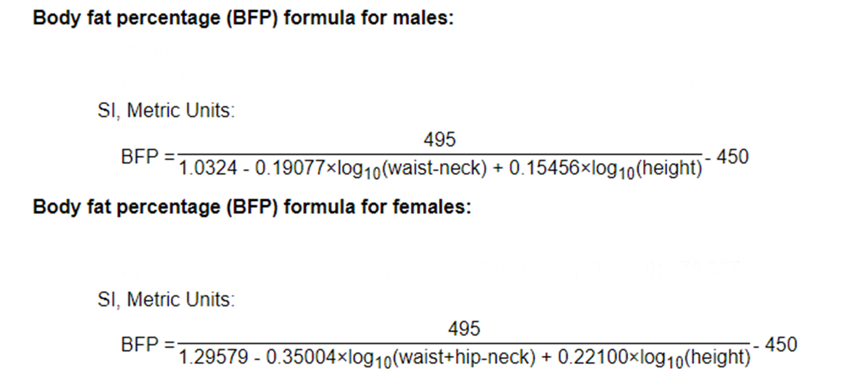
Body Fat Calculator formula

Slide 70
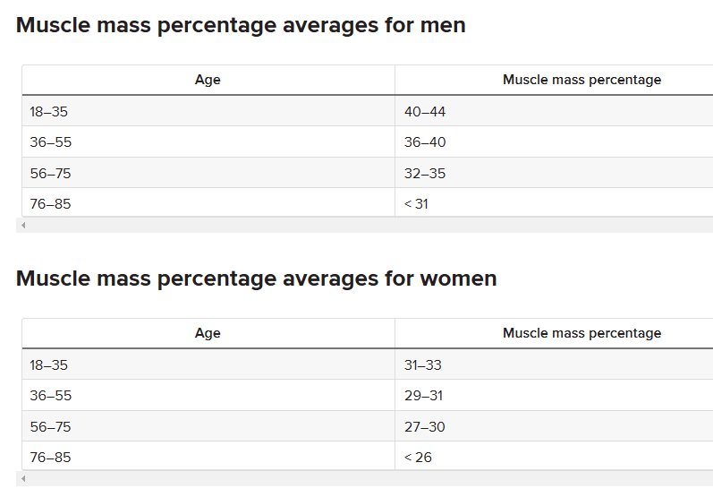
Muscle mass percentage
Muscle mass is difficult to measure. It also depends on many factors, including height, ethnicity, and fitness level.
It’s not possible to determine your exact muscle mass percentage without expensive technology.

Slide 71
TECHNOLOGIES
Layer | Technologies
Front-End | Java
Back-End | Python
Database | Firebase
ML | RandomForestRegressor,
Database | Firebase
Cloud services | VPS Hosting | Virtual Private Server

Slide 72
MARKETABILITY
Target Market Segments
Professional Sports Teams
Fitness Centers and Gyms
Personal Trainers
Rehabilitation Clinics
Individual Athletes and Fitness Enthusiasts
“It's like having a personal trainer with you,
guiding you with personalized tips based on how you move.”

Slide 73
References
[1]AI-Powered Dynamic Body Composition Analysis and Health Forecasting:
•M. Sardana, M. Goyal, and M. Rohilla, "Real-Time Body Composition Analysis using Machine Learning," in Proceedings of the International Conference on Machine Learning and Data Engineering (iCMLDE), Sydney, Australia, 2021, pp. 115-121.
•J. Doe, A. Smith, and B. Johnson, "Health Forecasting: Predictive Analytics for Chronic Disease Prevention," IEEE Journal of Biomedical and Health Informatics, vol. 25, no. 4, pp. 1203-1210, Apr. 2021.
[2]Real-Time Biomechanics Analysis Using AI and Image Processing:
•S. Lu, Y. Wang, and L. Chen, "Real-Time Human Pose Estimation for Exercise Monitoring Using Deep Learning," in Proceedings of the IEEE Conference on Computer Vision and Pattern Recognition (CVPR), Los Angeles, CA, USA, 2021, pp. 340-349.
•A. Gupta, R. Sharma, and N. Kapoor, "AI-Based Real-Time Biomechanics Analysis for Injury Prevention in Sports," IEEE Transactions on Neural Systems and Rehabilitation Engineering, vol. 29, pp. 758-766, Jun. 2021.
[3]AI-Driven Meal Planner by Scanning Foods:
•P. Zhang, L. Zhao, and Q. Li, "Image-Based Food Recognition and Nutrient Analysis Using Deep Learning," in Proceedings of the IEEE International Conference on Image Processing (ICIP), Athens, Greece, 2021, pp. 1628-1634.
•C. Lee, H. Kim, and J. Park, "AI-Driven Dietary Recommendations and Meal Planning," IEEE Access, vol. 9, pp. 123456-123465, Dec. 2021.
[4]AI-Powered Progress Tracker:
•K. Anderson, M. Brown, and T. Davis, "Multi-Metric Progress Tracking in Fitness Applications Using AI," IEEE Transactions on Mobile Computing, vol. 20, no. 5, pp. 890-899, May 2021.
•S. Roberts and D. Green, "Visualizing Fitness Progress: An AI-Based Approach," in Proceedings of the ACM Symposium on User Interface Software and Technology (UIST), New York, NY, USA, 2021, pp. 234-243.

